Slide 1
Gowanda Area Redevelopment - Peter Cooper Project Prepared by M. Hutchinson
Peter Cooper Factory 1970

Slide 2
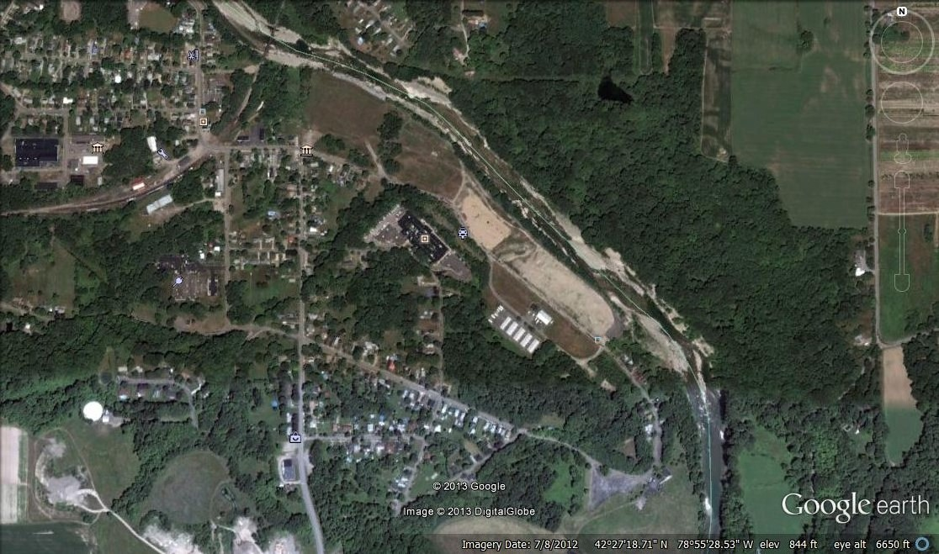
Site Location
Palmer Street Gowanda, New York

Slide 3
1.0 SITE OWNERSHIP HISTORY
Home Eastern Tanners Glue, later known as Peter Cooper Glue from 1904 to 1976 (the worlds largest glue factory).
Sold to Rousselot Gelatin Corp in 1976 a French company that made synthetic adhesives until 1985.
Sold to Jim Car Corp, a no-asset company in 1988.
Acquired by Gowanda Area Redevelopment Corp in 2009.
Leased in perpetuity to the Village of Gowanda December 8th 2009.

Slide 4
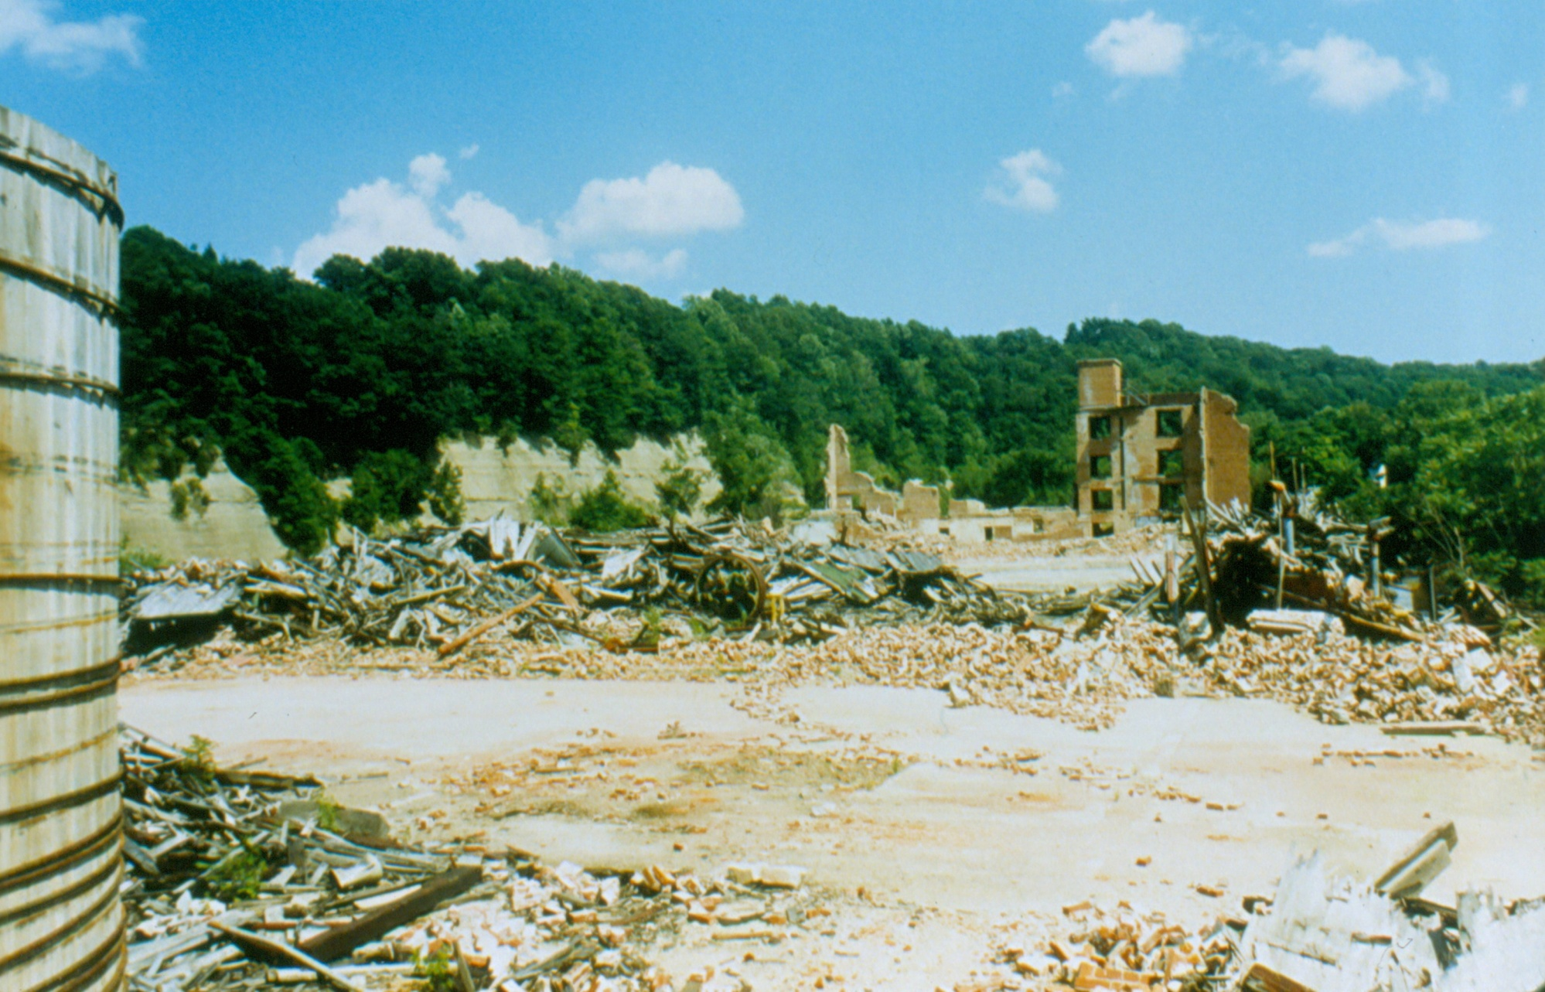
2.0 Site Environmental Issues

Slide 5
2.0 Summary of Environmental issues
The Site was polluted as a result of the by-products of animal glue manufactured from the waste material from tanneries in the north eastern United States.
Site pollution impacted ground water, soil and surface water.
Site pollution consisted of Chromium, Arsenic, Zink and TCE.
The site was placed on the NYS superfund list in 1987 but was removed in 1991 for legal reasons.
In 1992 the Cattaraugus Creek Task Force was created to address environmental issues at the site.
In 1998 the site was added to the EPA superfund list ( class 2)

Slide 6
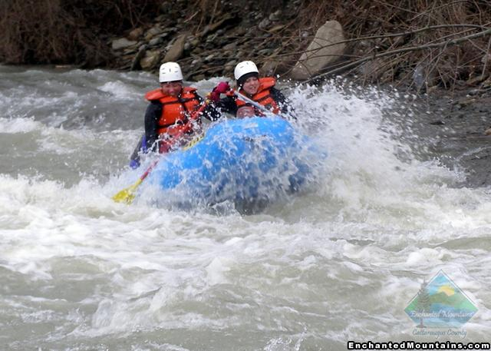
3.0 Site Reuse Development

Slide 7
3.0 Site Reuse Development
In 1996 the Cattaraugus Creek Task Force receives a technical assistance grant from the New Jersey Institute of Technology. (Bill Larow)
In 2001 the Village of Gowanda receives a $100,000 EPA grant to access reuse options
The Village partners with UB to develop reuse and legal options.
In 2002 after extensive public input and assistance from UB and the UB School of Law passive/active recreational with a commercial option was determined to be the best site reuse.
Notes:
Bill Larow contacts CCTF after he retires from DEC and starts teaches and NJIT. NJIT helps dispute the Obrian @ Gear site assessmant and the de listing by DEC

Slide 8
4.0 Site Cleanup
In 2005 EPA sign the Record of Decision requiring the responsible parties (PRPs) to cleanup the site.
In 2009 the responsible parties (PRPs) complete site environmental remediation at a cost of $2,650,000.
On August 2, 2011 EPA reclassifies the site as a class 4 site no longer posing a threat to public health or the environment.

Slide 9
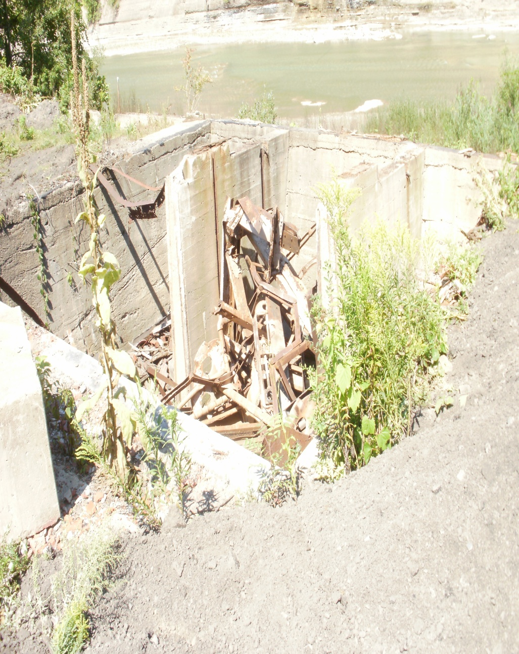
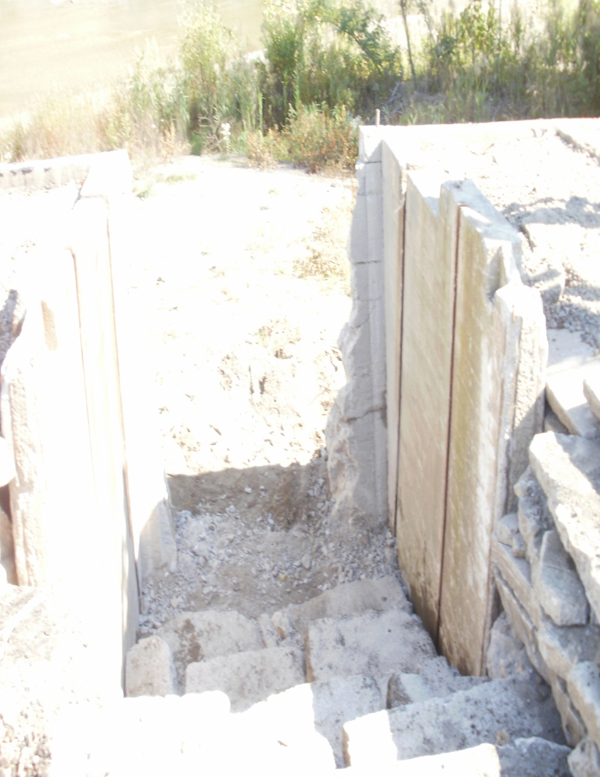
5.0 Site Reuse
Converted a water intake to creek access

Slide 10
5.0 Site Reuse and Economic Development
After extensive public input the area residents express a strong preference for passive/active recreational site reuse.
Reuse is consistent with the Village economic revitalization study (H. Sicherman Study).
Reuse is consistent with the Collins/Gowanda Joint Master Plan.
Fishing is a 6 billion dollar industry in up State New York.
Cattaraugus Creek is a top 10 Trout fishery
Rafting is a multi million dollar industry and is already having an economic impact on the Gowanda area.
In July 2012 Senator Young and Assemblyman Giglio get an amendment to Article 42 of New York State law and add Cattaraugus Creek as an Inland Waterway, making Collins, Gowanda and Persia water front communities.
Notes:
Sicherman study recommend * Promote the area as a destination for nature based tourism * Expand public and private recreational and leisure facilities * Attract businesses related to fishing, hiking , and other adventure sport.

Slide 11
6.0 Project Funding
Site Environmental Remediation 2.65 million dollars is funded by the (PRPs)
Site O&M is paid to the Village as needed from a $170,000 trust account set up by the PRPs. Any excess O&M funds are given to GARC and the Village for site improvements after the 5 yr performance review.
Site Legal Admin and Technical reimbursement for past and future clean up efforts $70,000.
Site improvements funds provided to GARC $234,000.
EPA funded Technical assistance grant paid to UB and NJIT.
EPA Superfund redevelopment Grant $100,000.
New York State environmental Protection design grant $76,500 with local match of $19,125 funded by donated time and site improvement funds.
Environmental Protection construction grant $540,333 with local match of $290,833 funded by donated time and materials from Gernatts.
$203,952 Cattaraugus County construction grant (Casino funds)
$625,000 Economic Development Council construction funding Parks Grant ($500,000 in grant and $125,000 in local share contribution)

Slide 12
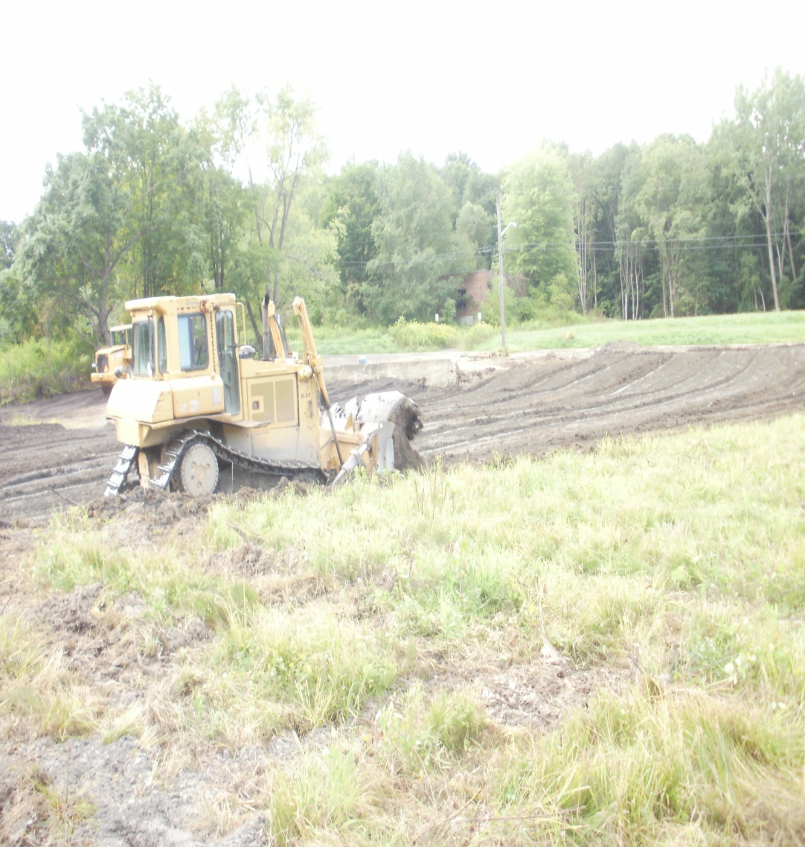
Site Improvements
Building foundation removal Placement of 13,000 yds of cover material

Slide 13
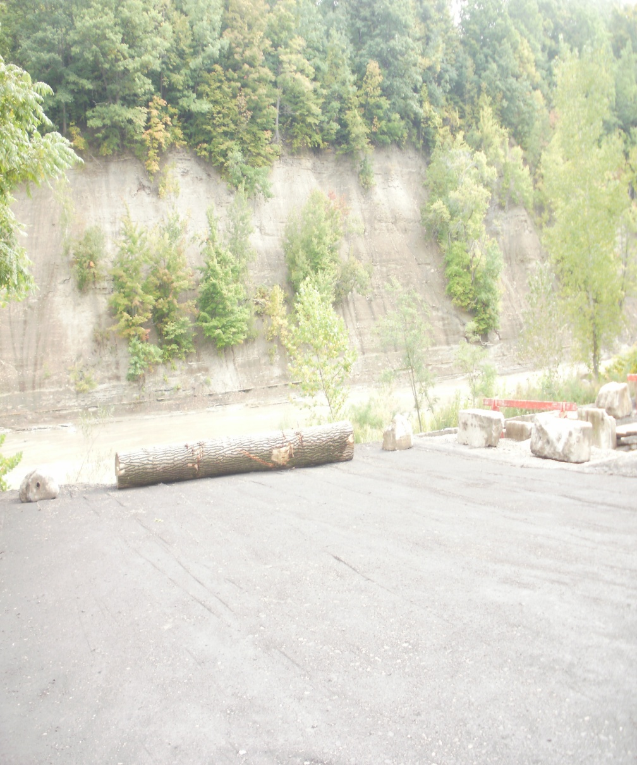
Site Improvements
Remove leachate discharges Improve creek access and parking

Slide 16
7.0 Accomplishments and Next Steps
Environmental Remediation completed 2.65M
5 year EPA performance Review 2014
Site Design Completed June 2013 costing $76,500
Site sub-base grading to be completed fall of 2013 costing $540,333.
Site removed from superfund list 2014
NYS Parks grant application August 2013.
Obtain funding for park completion
For additional information and questions mikehutch04@aol.com

Slide 17
2014 Parks Grant Scope of Work
New Parking Lot - $165,209
Asphalt Walkways - $280,146
Perimeter Fencing - $25,998
Trees - $40,417
Basketball Court - $24,780
Gazebo - $13,695
Construction oversight - $47,243
Mobilization - $27,512
total $625,000

